Slide 1
The waterfall
The waterfall

Slide 2
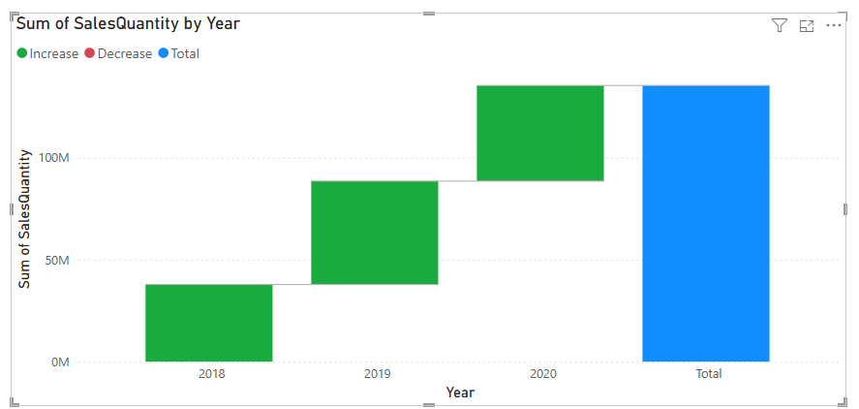
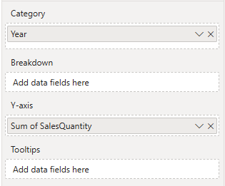
The waterfall
Note: This workshop is using Sales.xls of Excel Sources
In Power BI, click the Waterfall chart icon in the Visualizations pane. Drag it to the canvas
Let’s analyse how sales quantities changed by year.

Slide 3
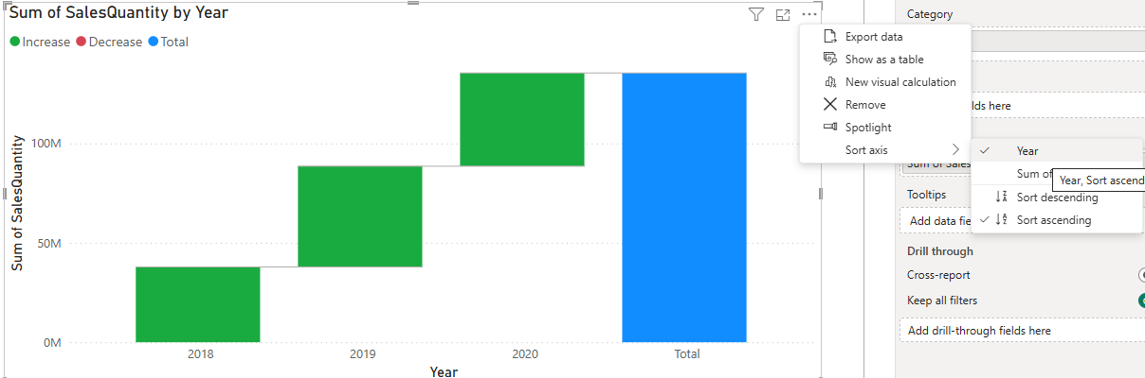
The waterfall
Note: If the year values are not displayed in theincreasing order then it is possible to change the order
1
Click the three points
2
3
Chose the year as sorting critera
Chose the sort axis
4
Chose ascending order

Slide 4
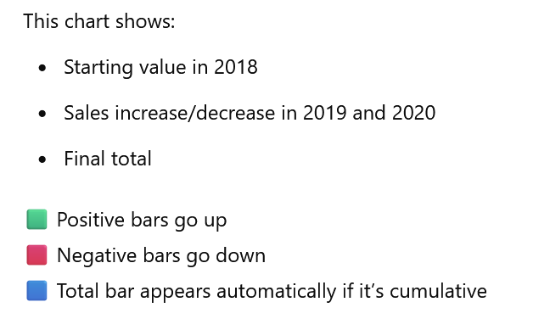
The waterfall

Slide 5
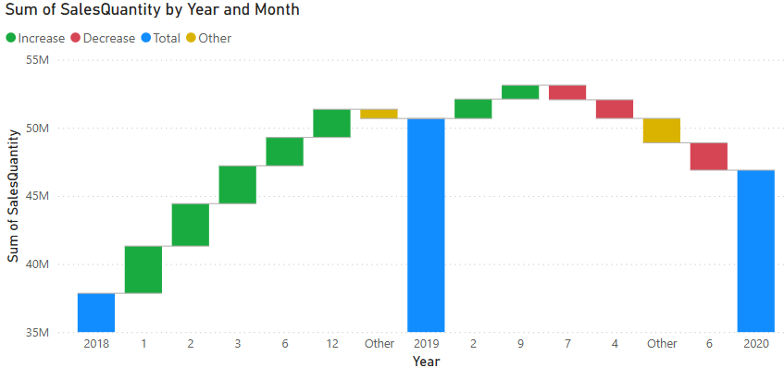
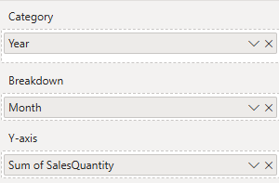
The waterfall
Add Month from DimDate to the Break Down to break down the evolution of the trend through months

Slide 6
The waterfall
What Does the Breakdown Do?
It decomposes each year’s change by the Month field
Now, for each year (2018, 2019, 2020...), Power BI shows:
How each Month contributed to the increase/decrease in Total Sales for that year.

Slide 7
The waterfall
Tips for Using Breakdown
Keep breakdown fields max ~5-10, otherwise it becomes cluttered.
Make sure relationships between your fact and dimension tables are active.
Clean field values long or unclear values will clutter the visual.
You can hover over each segment to see the exact contribution in the tooltip.

Slide 8
The waterfall
Why Is Other Appearing in Your Chart?
Power BI shows:
The top few months that contributed most to the change between years
Remaining months are grouped as "Other"

Slide 9
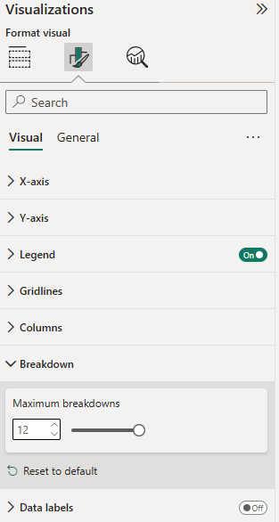
The waterfall
How to Control or Avoid "Other"
1
Change Maximum Breakdown Elements
Click on the Waterfall chart.
Go to the Format pane.
Expand Breakdown section.
Set Max number of breakdowns to a 12 (default is usually 5).
2
3

Slide 10
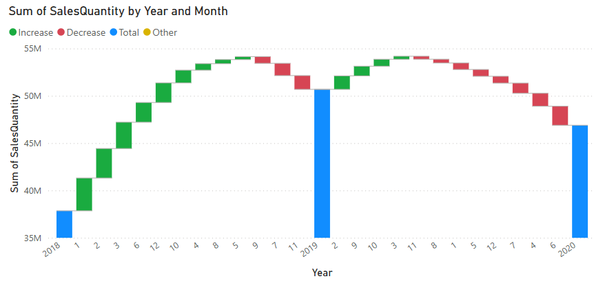
The waterfall
The result will be

Slide 11
Thank you
Thank you

